Slide 1
Lab 3: Digital Signal Processing
Sean Prokop
Winter 2019

Slide 2
Objective
The objective of this lab is to learn about the time domain and frequency domain and how to use both of them in Matlab. We learn how an FFT displays the frequency components of a signal and how different sampling rates affect signals.

Slide 3
Part 1: Signal Processing with MATLAB and Arduino

Slide 4

Challenge #1 - Onramp Tutorial
Part 1
There was nothing really new from what I already knew about Matlab prior to this.

Slide 5
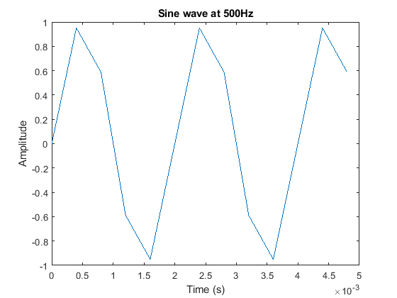
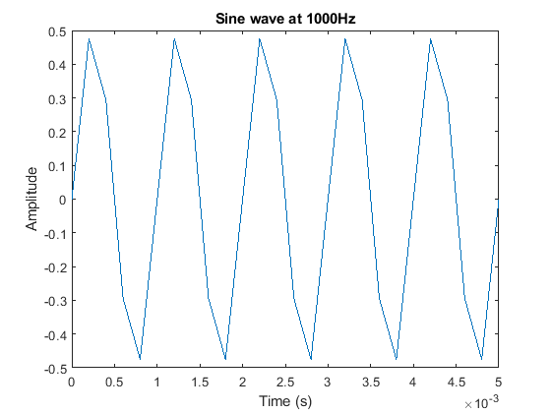
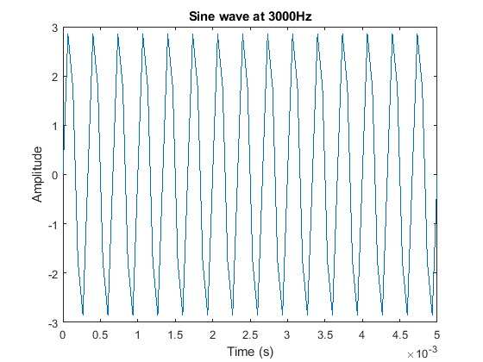
Challenge #2A - Creating a signal in MATLAB
Part 1

Slide 6
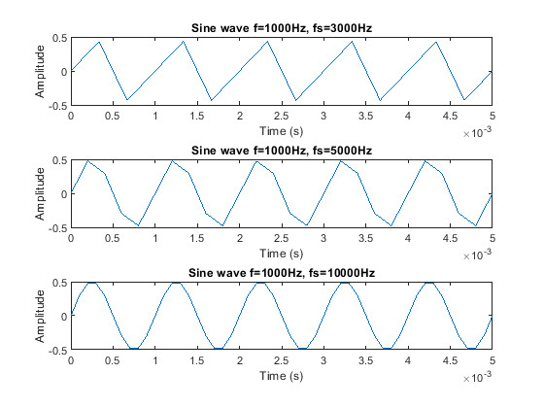
Challenge #2A - Creating a signal in MATLAB
Part 1
As the sampling rate is increased the wave start to look more like an actual sine wave. The first plot with the lowest fs looks like a sawtooth wave, the second one looks a little bit more like a sine wave, and the last one looks like a sine wave.

Slide 7
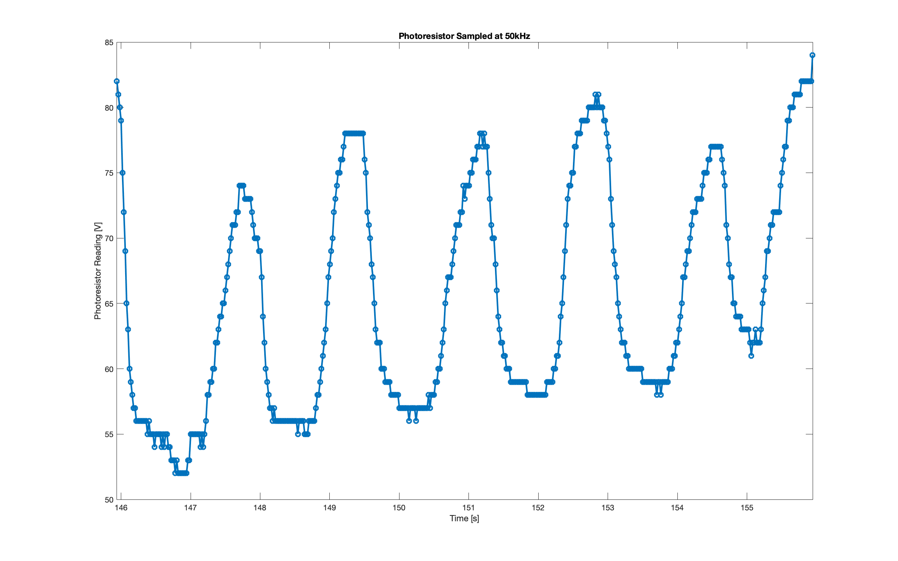
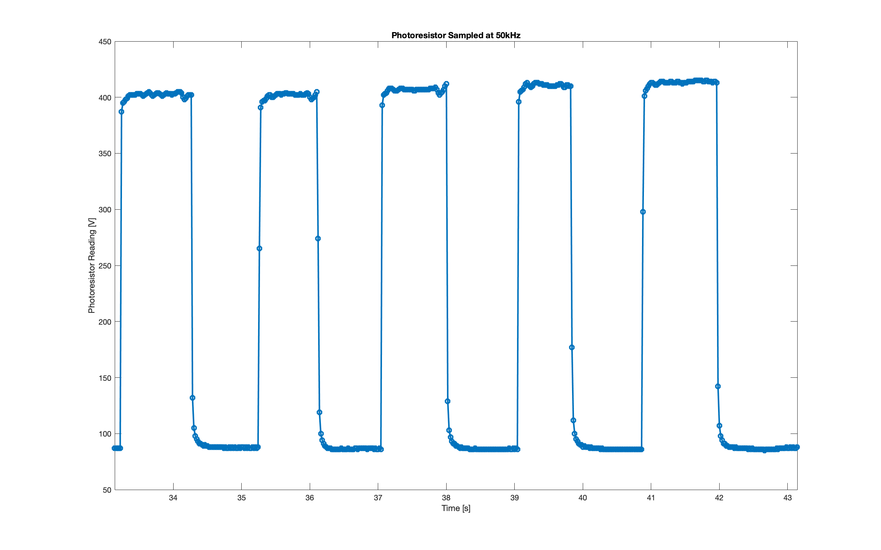
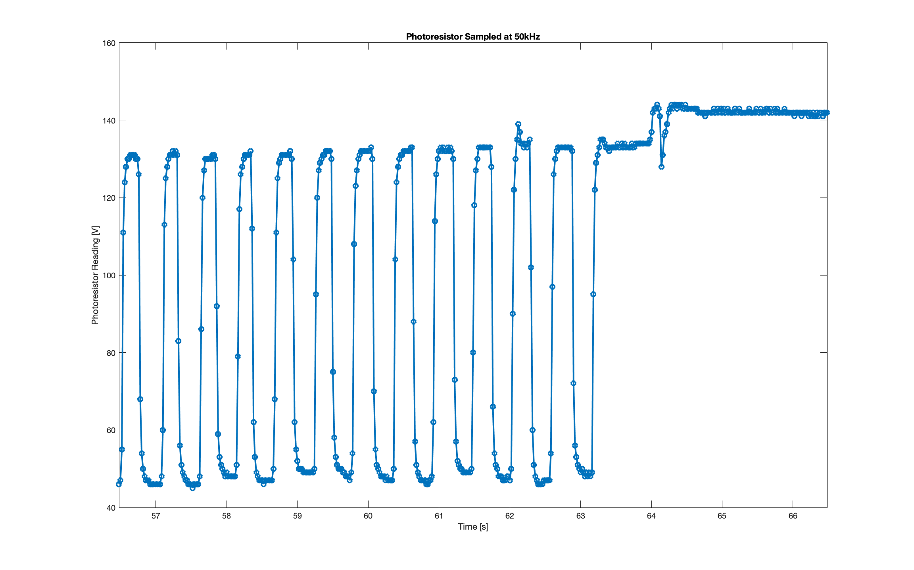
Challenge #2B - Creating a signal in MATLAB + Arduino
Part 1
The amplitude for the 0.5Hz sine wave was about 10 units, the 2Hz sine wave was 40 units, and the square wave was 150 units.

Slide 8
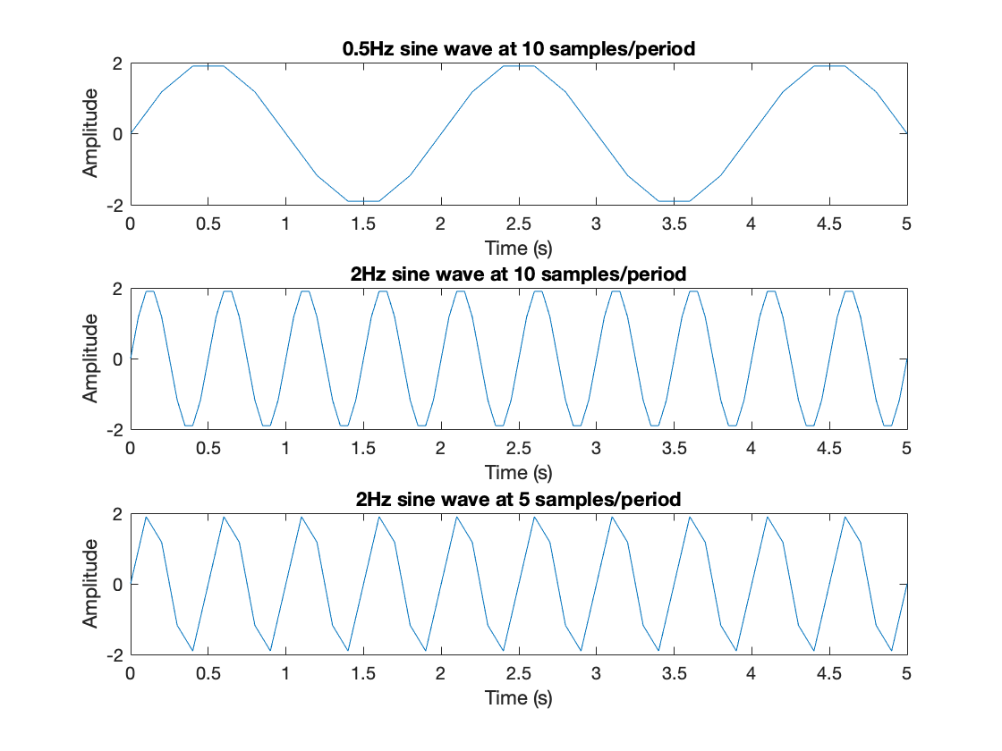
Challenge #3A – Generating Signals via Functions
Part 1

Slide 9
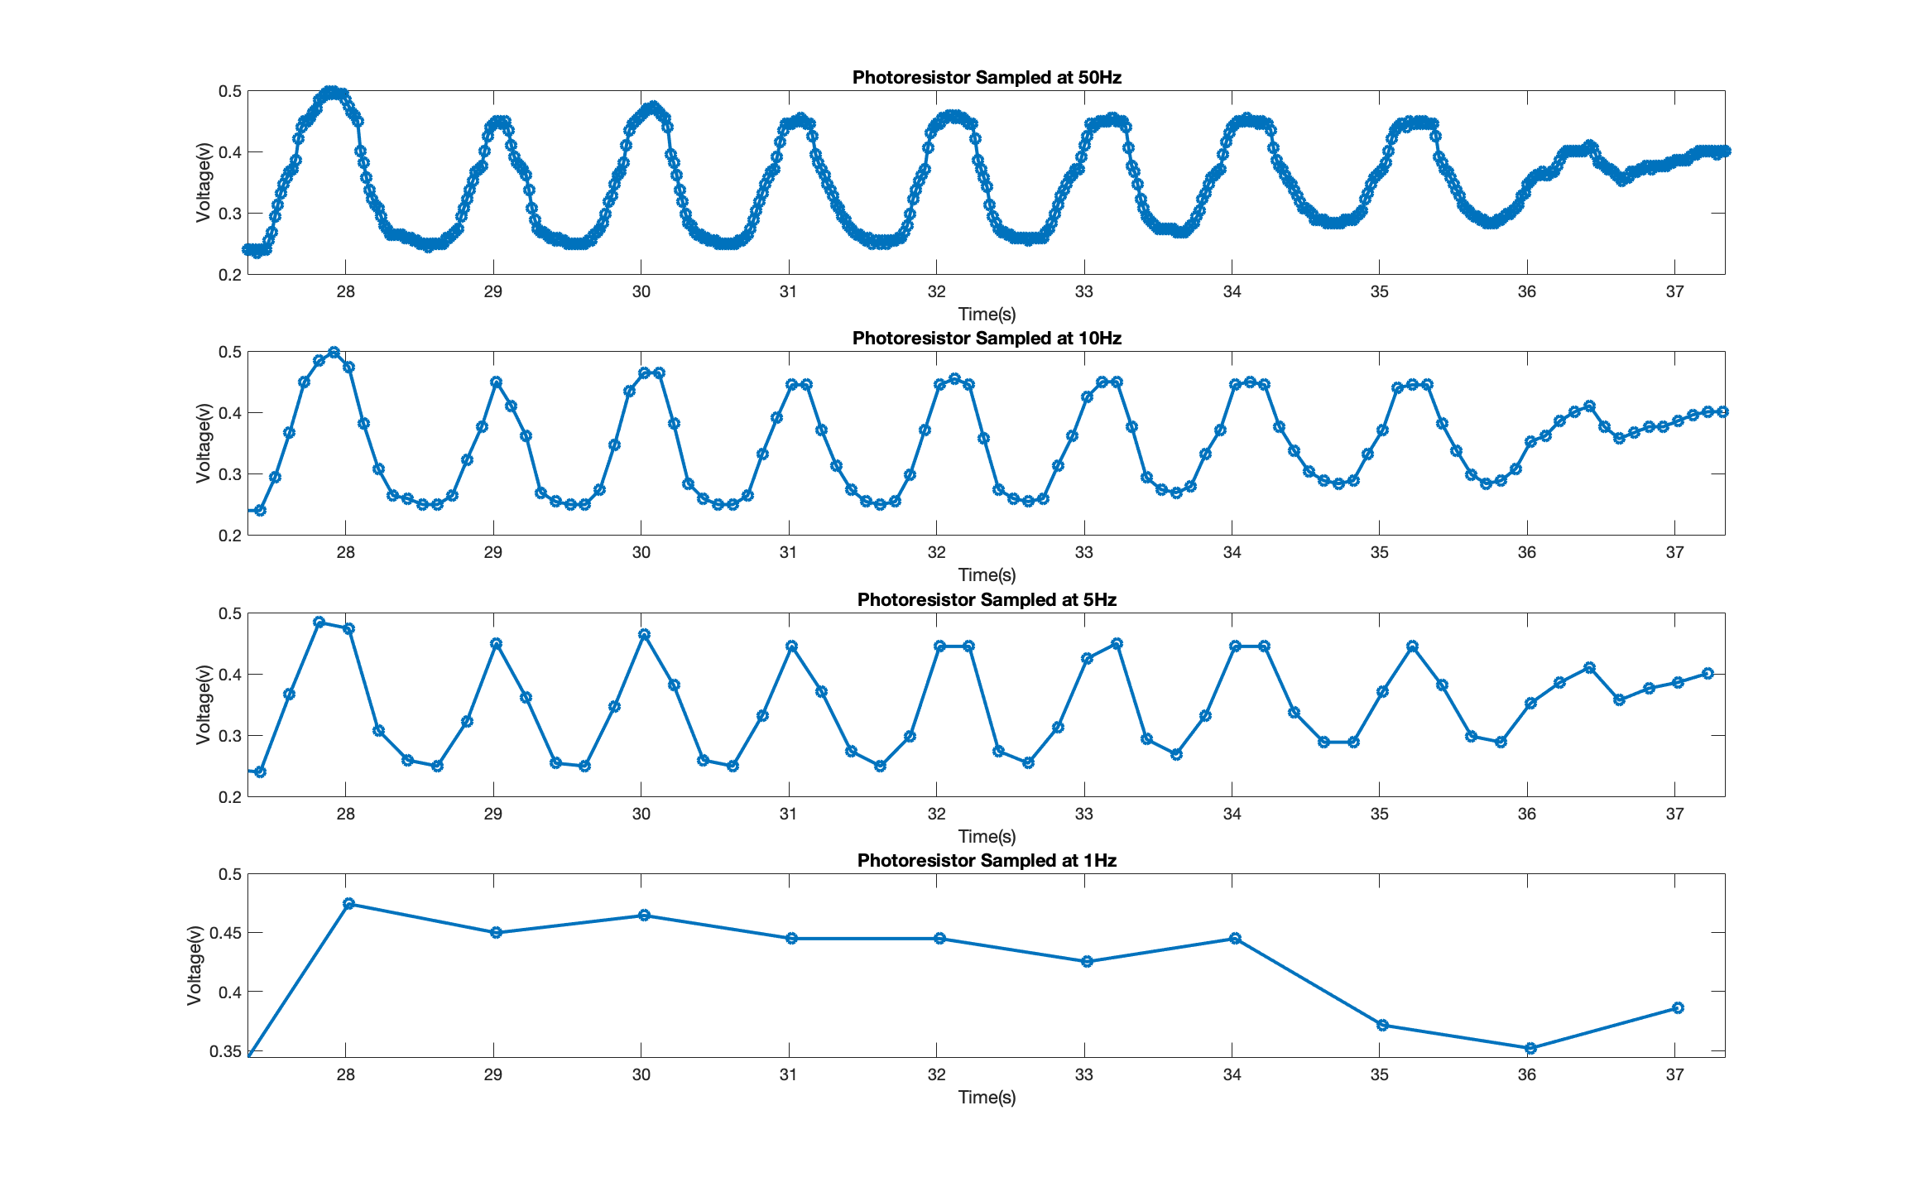
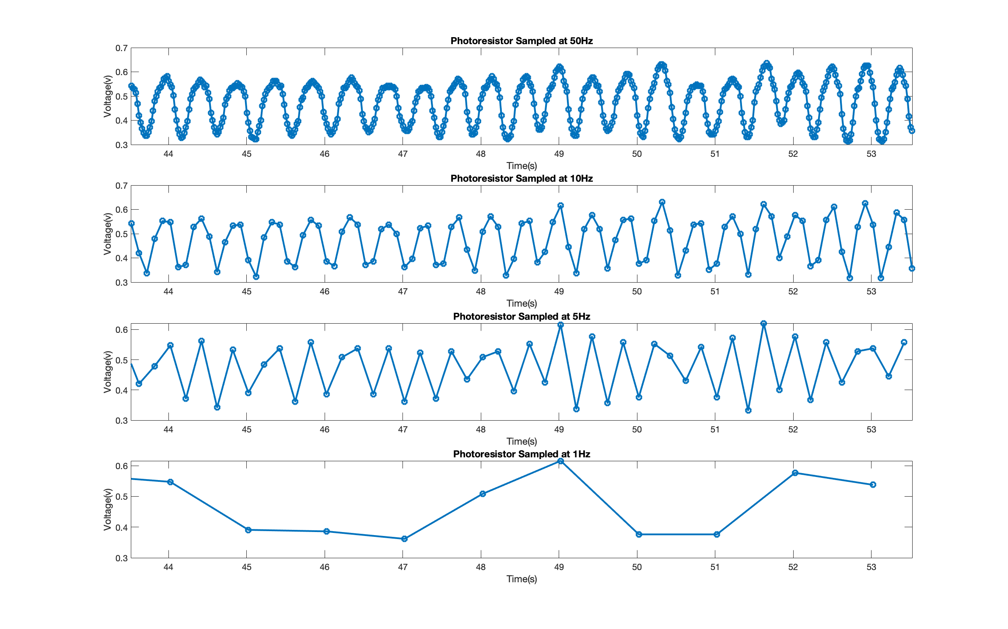
Challenge #3B – Sampling with MATLAB & Arduino
Part 1
When the lower the sampling rate gets, the less the signal looks like a sine wave. At 10Hz it’s basically the same as at 50Hz because it is sampled well above the actual frequency, and 5Hz is basically the same for the same reason. Sampled at 1Hz, the 1Hz signal looks like a line because it is sampled at the same point on the wave every time, and for the 2Hz signal it should look like a line because it is again sampled at the same point, but it does not look perfect because of human error on generating the wave.

Slide 10
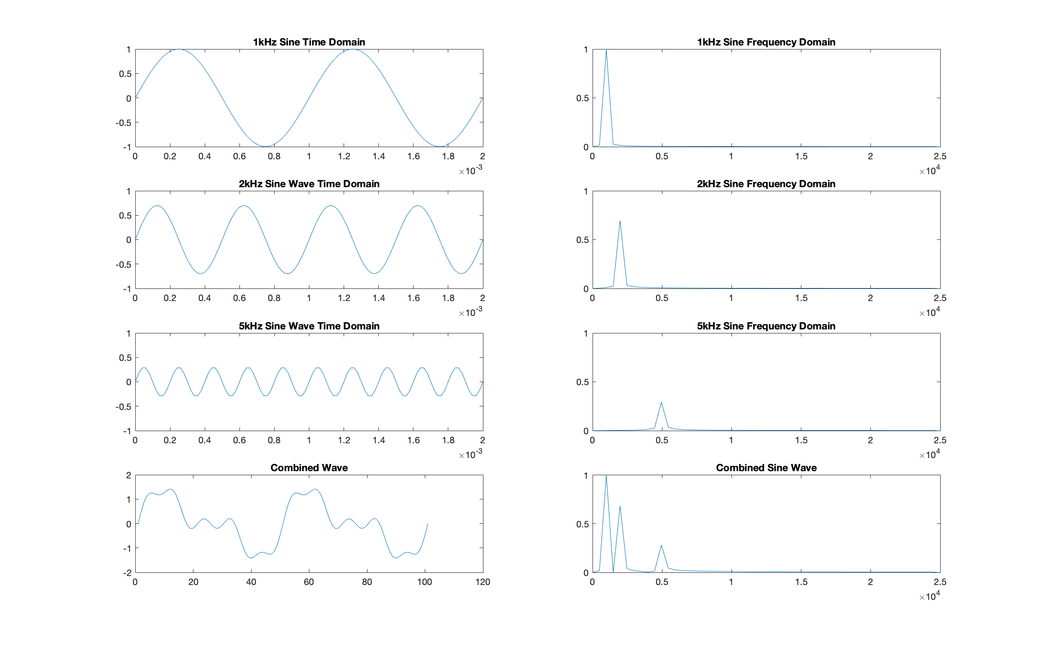
Challenge #4A – Time vs. Frequency Representations
Part 1
The power spectrum plots show the frequency components of the signal, the spike means there is a frequency component at that point. For the first three there is only one because it is a single frequency sine wave, but the third has all three together.
The frequency domain allows us to see what frequencies are present in our signal which is useful for filtering because we can see what components are there that we may not want.

Slide 11
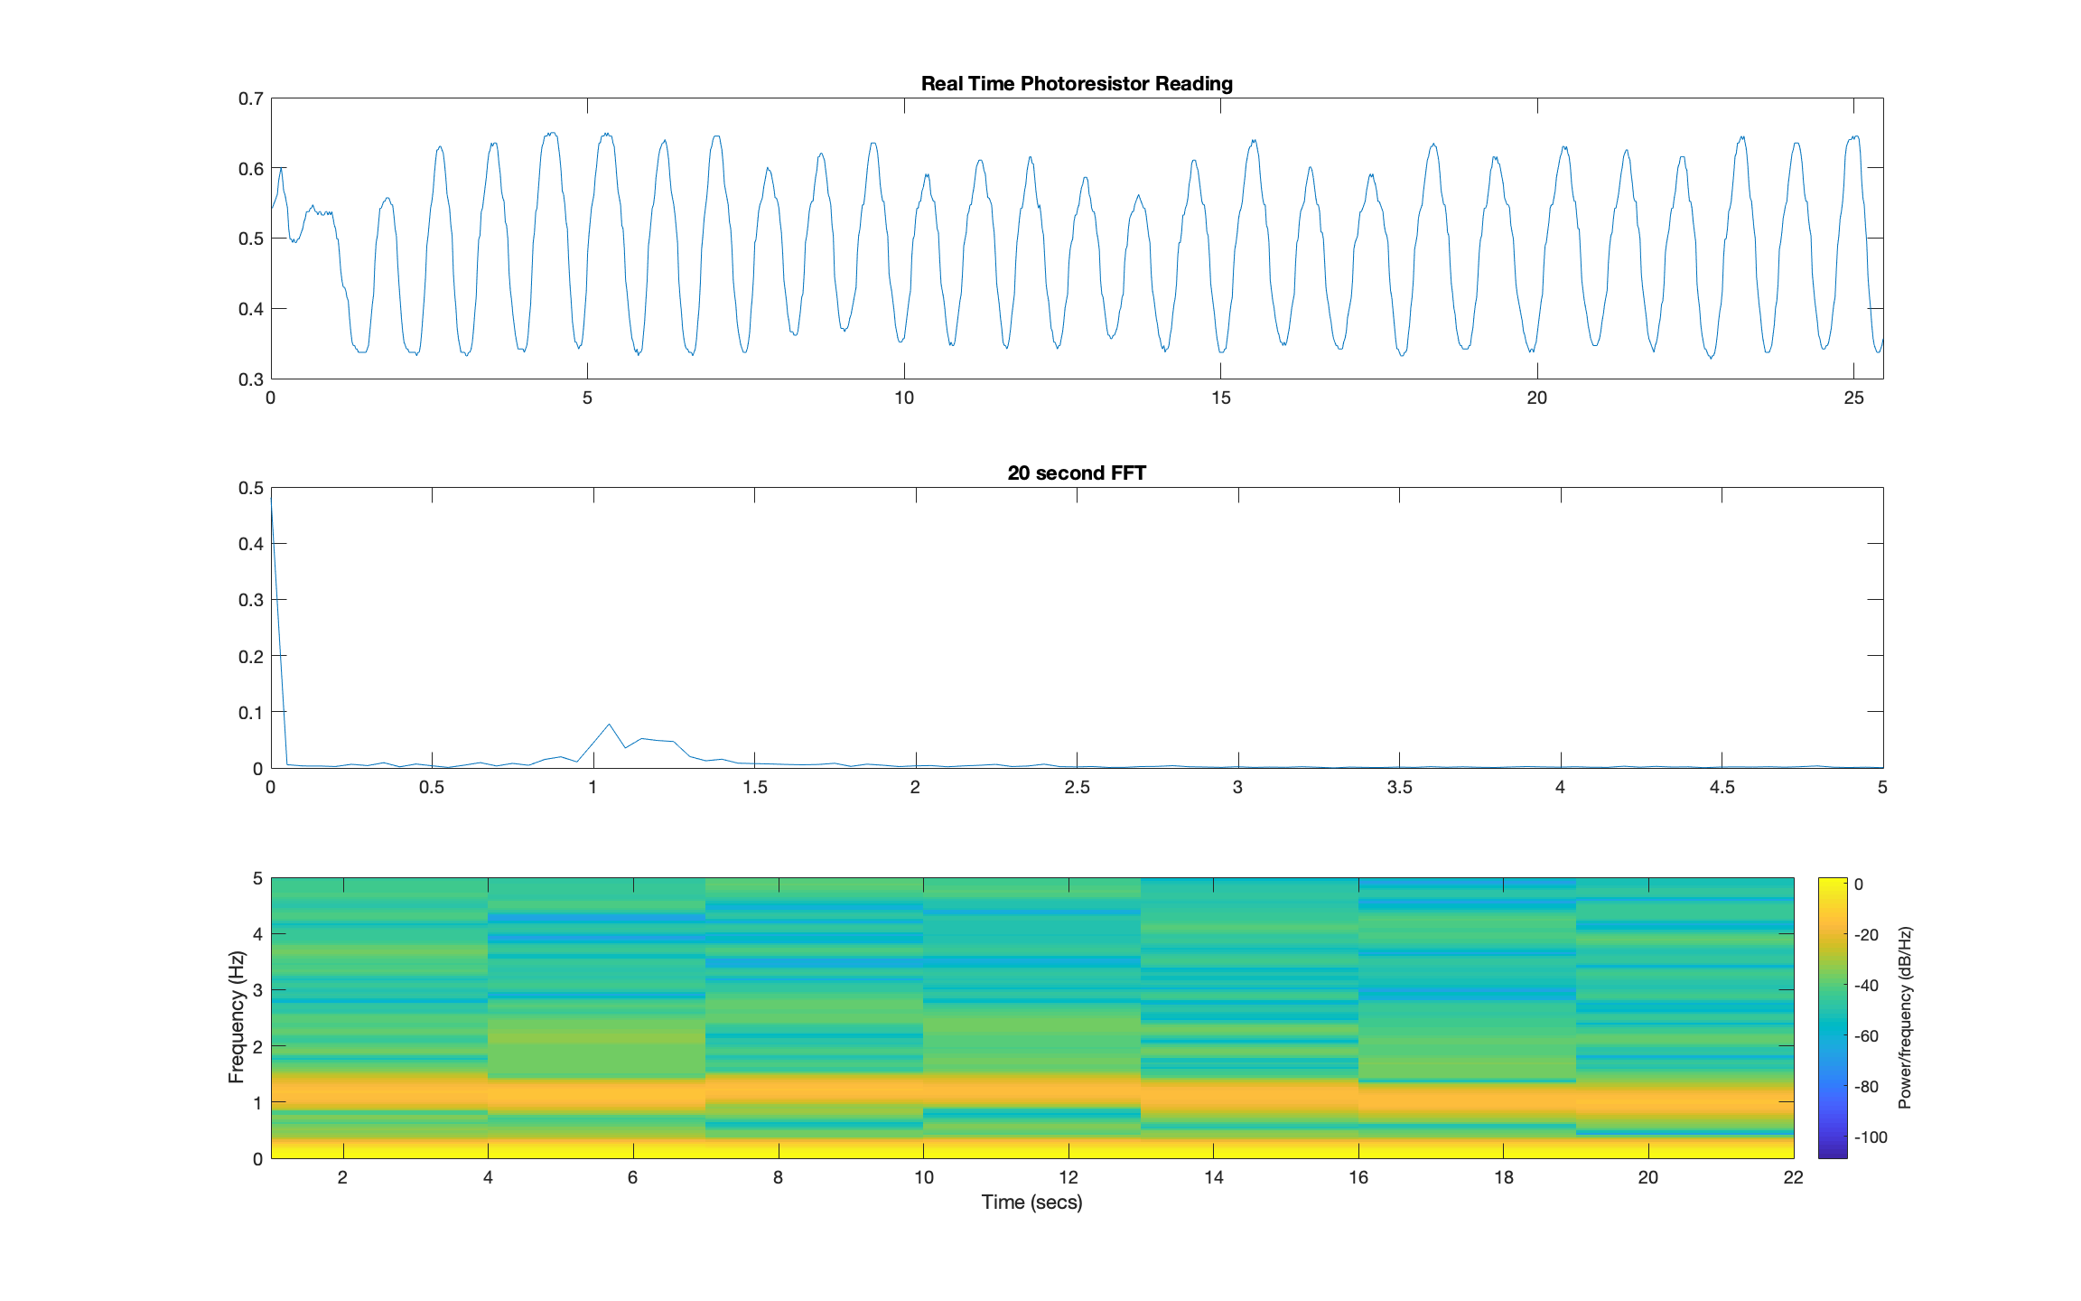
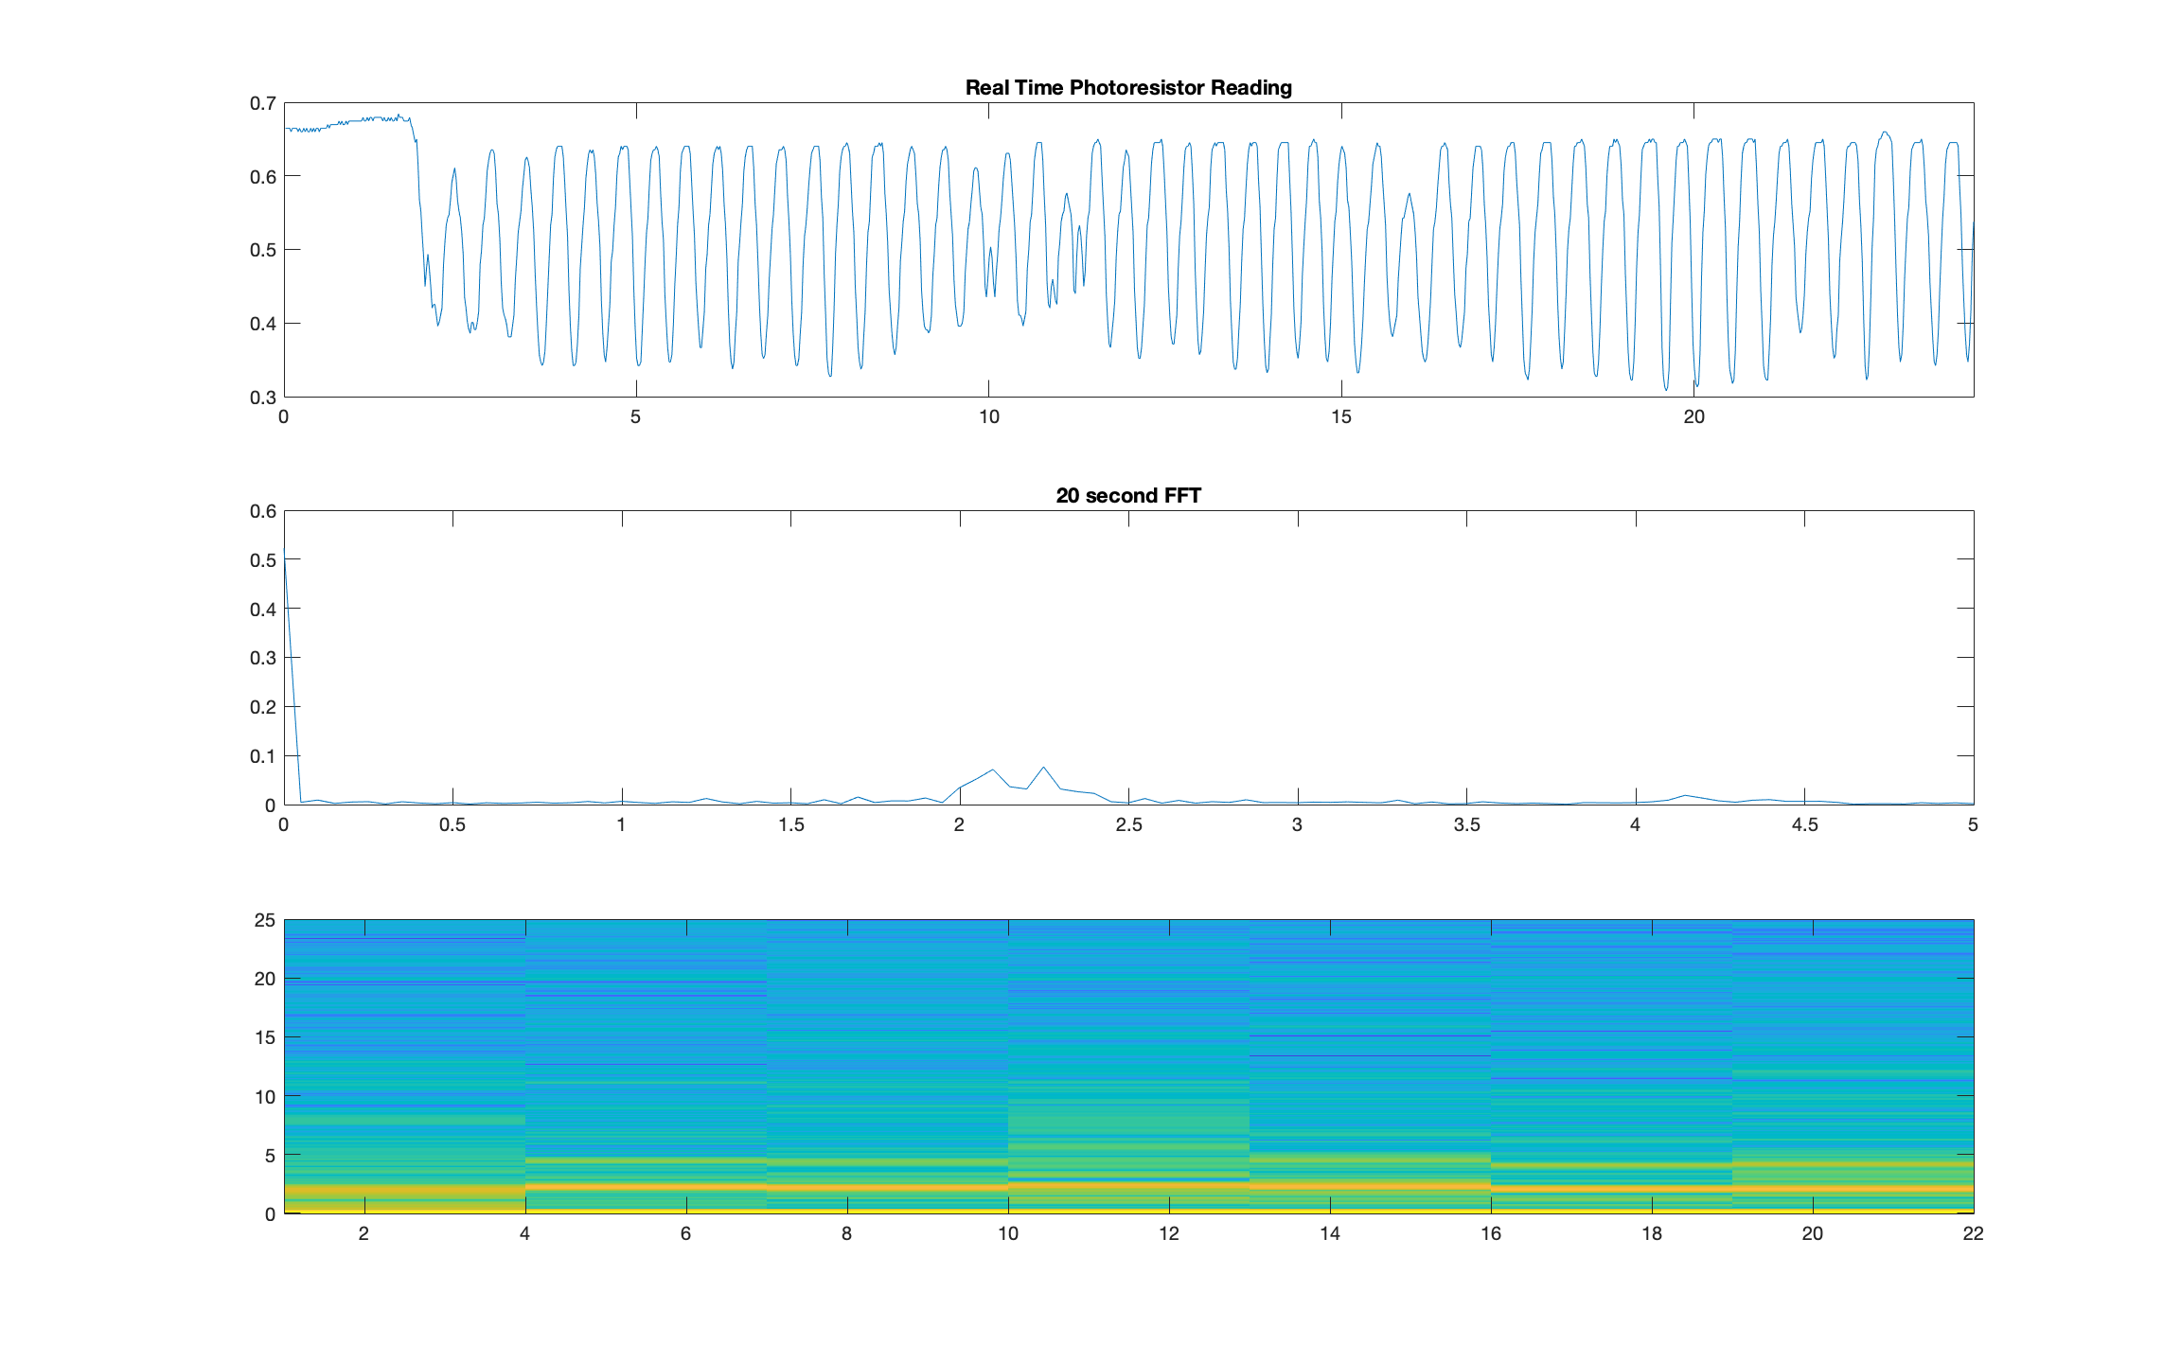
Challenge #4B – Time vs. Frequency Representations
Part 1

Slide 12
Challenge #4B – Time vs. Frequency Representations
Part 1
The power spectrum was showing a spike at 0Hz and small spikes at ~1Hz for the 1Hz sine wave and ~2Hz for the 2Hz sine wave. The 0Hz is from the time between running the script and actually starting the wave. The other spikes show the frequency of the sine wave I was generating.
The spectrogram shows bright spots at 0Hz and either 1Hz or 2Hz depending on which wave it is. This is related to my hand moving frequencies because it is actually plotting the frequency of my hand.
It produces a choppier FFT because the FFT_PLOT_DURATION is multiplied by the sampling frequency to set the number of points for the FFT.

